Slide 1
Network Modeling

Slide 2
Introduction
A number of business problems can be represented graphically as networks.
We focus on several such problems:
Transshipment Problems
Shortest Path Problems
Maximal Flow Problems
Generalized Network Flow Problems
The Minimum Spanning Tree Problem

Slide 3
Network flow problem characteristics
Network flow problems can be represented as a collection of nodes connected by arcs.
There are three types of nodes:
Supply
Demand
Transshipment
We’ll use negative numbers to represent supplies and positive numbers to represent demand.

Slide 4
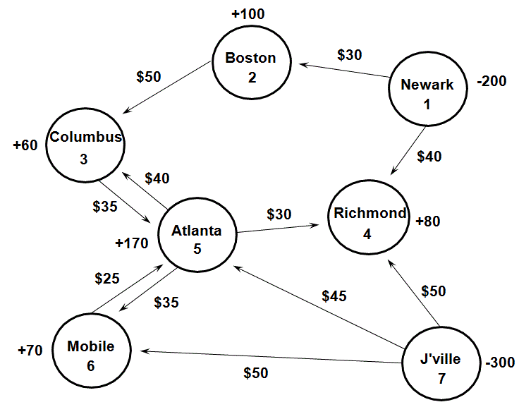
A Transshipment problem: The Bavarian motor company

Slide 5
Defining the decision variables
For each arc in a network flow model we define a decision variable as:
X_{ij} = the amount being shipped (or flowing) from node i to node j
For example…
X₁₂ = the # of cars shipped from node 1 (Newark) to node 2 (Boston)
X₅₆ = the # of cars shipped from node 5 (Atlanta) to node 6 (Mobile)
Note: The number of arcs determines the number of variables!

Slide 6
Defining the Objective Function
Minimize total shipping costs.
MIN: 30X₁₂ + 40X₁₄ + 50X₂₃ + 35X₃₅
+40X₅₃ + 30X₅₄ + 35X₅₆ + 25X₆₅
+ 50X₇₄ + 45X₇₅ + 50X₇₆

Slide 7
Constraints for network flow problems: The balance-of-flow rules
For Minimum Cost Network Apply This Balance-of-Flow
Flow Problems Where: Rule At Each Node:
Total Supply > Total Demand Inflow-Outflow >= Supply or Demand
Total Supply < Total Demand Inflow-Outflow <=Supply or Demand
Total Supply = Total Demand Inflow-Outflow = Supply or Demand

Slide 8
Defining the constraints
In the BMC problem:
Total Supply = 500 cars
Total Demand = 480 cars
For each node we need a constraint like this:
Inflow - Outflow >= Supply or Demand
Constraint for node 1:
–X₁₂ – X₁₄ >= – 200 (Note: there is no inflow for node 1!)
This is equivalent to:
+X₁₂ + X₁₄ <= 200
(Supply >= Demand)

Slide 9
Defining the constraints
Flow constraints
–X₁₂ – X₁₄ >= –200 } node 1
+X₁₂ – X₂₃ >= +100 } node 2
+X₂₃ + X₅₃ – X₃₅ >= +60 } node 3
+ X₁₄ + X₅₄ + X₇₄ >= +80 } node 4
+ X₃₅ + X₆₅ + X₇₅ – X₅₃ – X₅₄ – X₅₆ >= +170 } node 5
+ X₅₆ + X₇₆ – X₆₅ >= +70 } node 6
–X₇₄ – X₇₅ – X₇₆ >= –300 } node 7
Nonnegativity conditions
X_{ij} >= 0 for all ij

Slide 10
Implementing the model
See Excel formulation…

Slide 11
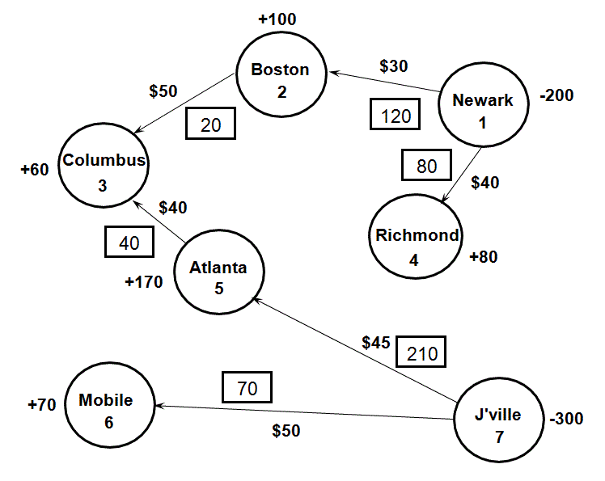
Optimal solution to the BMC problem

Slide 12
The shortest path problem
Many decision problems boil down to determining the shortest (or least costly) route or path through a network.
Ex. Emergency Vehicle Routing
This is a special case of a transshipment problem where:
There is one supply node with a supply of -1
There is one demand node with a demand of +1
All other nodes have supply/demand of +0

Slide 13
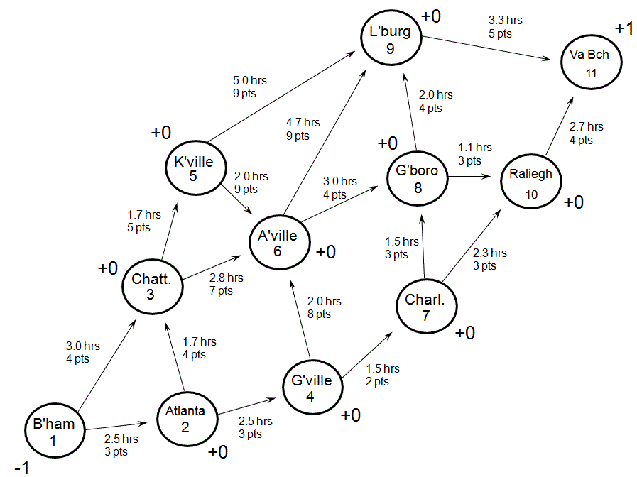
The American car association

Slide 14
Solving the problem
There are two possible objectives for this problem
Finding the quickest route (minimizing travel time)
Finding the most scenic route (maximizing the scenic rating points)
See Excel…

Slide 15
The maximal flow problem
In some network problems, the objective is to determine the maximum amount of flow that can occur through a network.
The arcs in these problems have upper and lower flow limits.
Examples
How much water can flow through a network of pipes?
How many cars can travel through a network of streets?

Slide 16
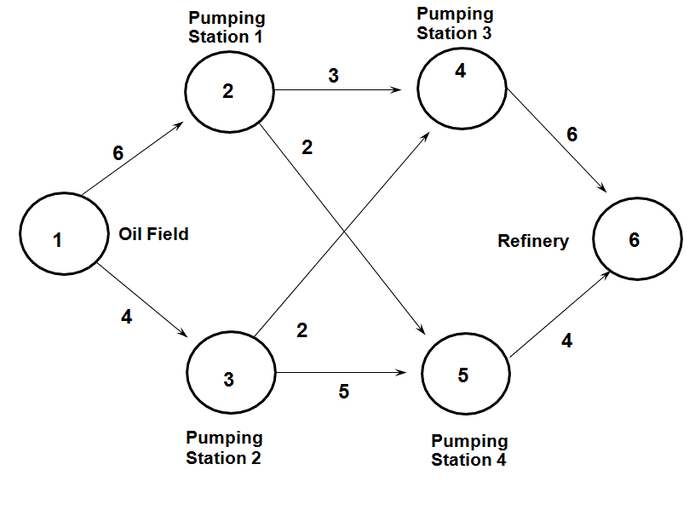
The Northwest Petroleum Company

Slide 17
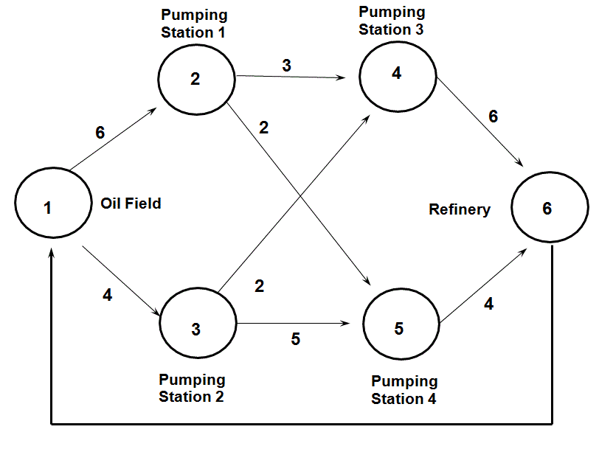
The Northwest Petroleum Company

Slide 18
Formulation of the max flow problem
MAX: X₆₁
Subject to: +X₆₁ - X₁₂ - X₁₃ = 0
+X₁₂ - X₂₄ - X₂₅ = 0
+X₁₃ - X₃₄ - X₃₅ = 0
+X₂₄ + X₃₄ - X₄₆ = 0
+X₂₅ + X₃₅ - X₅₆ = 0
+X₄₆ + X₅₆ - X₆₁ = 0
with the following bounds on the decision variables:
0 <= X₁₂ <= 6 0 <= X₂₅ <= 2 0 <= X₄₆ <= 6
0 <= X₁₃ <= 4 0 <= X₃₄ <= 2 0 <= X₅₆ <= 4
0 <= X₂₄ <= 3 0 <= X₃₅ <= 5 0 <= X₆₁ <= inf

Slide 19
Implementing the model
See Excel…

Slide 20
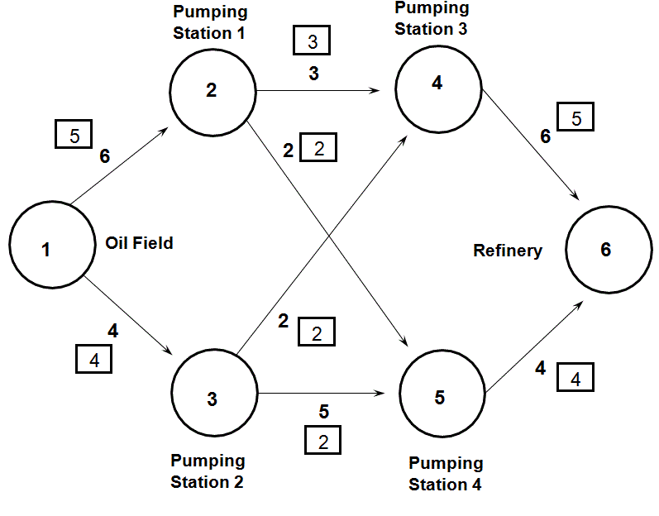
Optimal solution

Slide 21
Special modeling considerations: flow aggregation
+0
$3
$5
-100
1
3
5
+75
$4
$3
$4
$5
-100
2
4
6
+50
$5
$6
+0
Suppose the total flow into nodes 3 & 4 must be at least 50 and 60, respectively. How would you model this?

Slide 22
Special modeling considerations: flow aggregation
+0
+0
$3
$5
-100
1
30
3
5
+75
L.B.=50
$4
$3
$4
$5
-100
2
40
4
6
+50
$5
L.B.=60
$6
+0
+0
Nodes 30 & 40 aggregate the total flow into nodes 3 & 4, respectively.

Slide 23
Special modeling considerations: multiple arcs between nodes
$8
-75
1
$6
2
+50
U.B. = 35
Two (or more) arcs cannot share the same beginning and ending nodes. Instead, try...
+0
10
$0
$8
1
$6
2
+50
-75
U.B. = 35

Slide 24
Special modeling considerations: capacity restrictions on total supply
-100
+75
$5, UB=40
1
3
$4, UB=30
$6, UB=35
2
4
$3, UB=35
-100
+80
Supply exceeds demand, but the upper bounds prevent the demand from being met.

Slide 25
Special modeling considerations: capacity restrictions on total supply
-100
+75
$5, UB=40
1
3
$999, UB=100
+200
$4, UB=30
0
$6, UB=35
2
4
$999, UB=100
$3, UB=35
-100
+80
Now demand exceeds supply. As much “real” demand as possible will be met in the least costly way.

Slide 26
The Minimal Spanning Tree Problem
For a network with n nodes, a spanning tree is a set of n-1 arcs that connects all the nodes and contains no loops.
The minimal spanning tree problem involves determining the set of arcs that connects all the nodes at minimum cost.

Slide 27
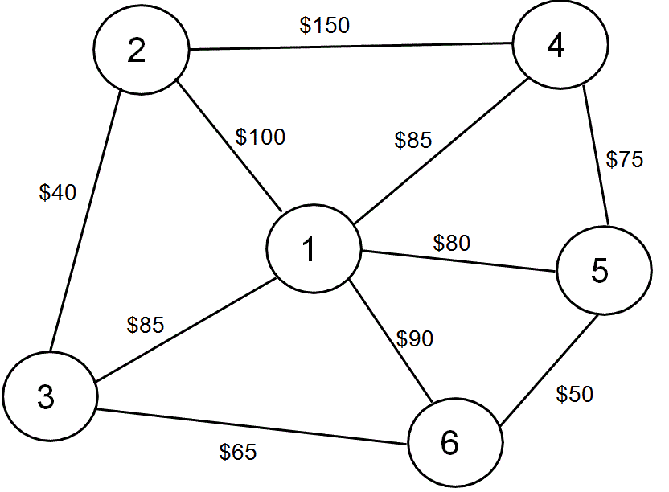
Minimal Spanning Tree example: Windstar Aerospace Company
Nodes represent computers in a local area network.

Slide 28
The Minimal Spanning Tree algorithm
1. Select any node. Call this the current subnetwork.
2. Add to the current subnetwork the cheapest arc that connects any node within the current subnetwork to any node not in the current subnetwork. (Ties for the cheapest arc can be broken arbitrarily.) Call this the current subnetwork.
3. If all the nodes are in the subnetwork, stop; this is the optimal solution. Otherwise, return to step 2.

Slide 29
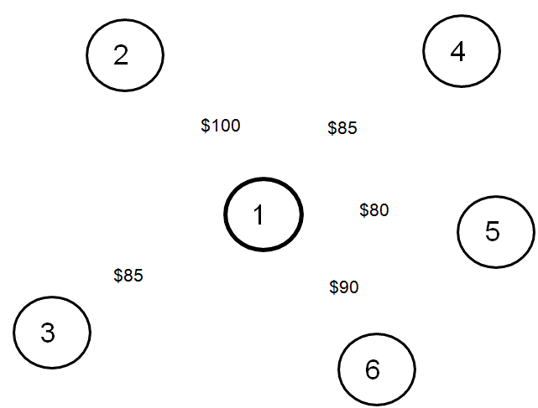
Solving the example problem

